Slide 1
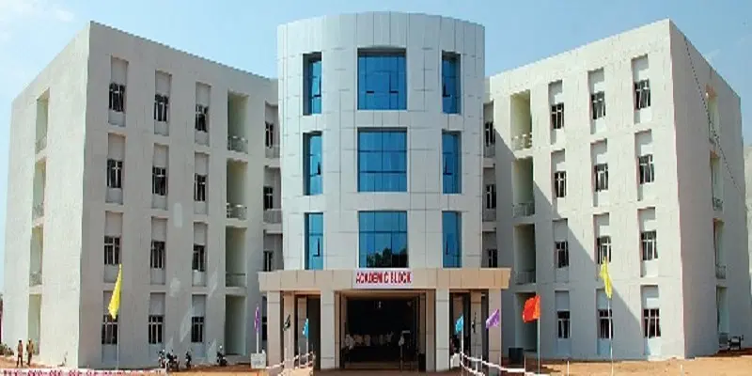
RGUKT BOT

Slide 2
Team Members
N190011 - Nedunuri Sneha Madhuri
N190087 - Baluguri Lakshmi Prasanna
N190970 - Tolusuri Sravanthi
N190067 - Kotipalli Vishaka Nagamani Devi
N190971 - Gadi Sai Deekshitha

Slide 3
Table of contents
1.Abstract
2.Introduction
3.Related Works
4.Proposed methods
5.Experimental setup
6.Conclusion
7.Future scope
8.References

Slide 4
Abstract
This project presents the development of a comprehensive chat bot system designed to provide information about the RGUKT campus. Users can engage with the chat bot to inquire about various aspects of RGUKT campus life, including facilities, mess timings, and other campus-related information. The chat bot provides prompt and accurate responses to user queries.
A notable feature of the chat bot is the 'About' section, which users can click to view detailed content regarding RGUKT. This section provides comprehensive information about the institution, its history, academic programs, and other relevant details. In the feedback section user can give feedback The integration of frontend and backend technologies in this project ensures a robust and efficient chat bot system, aiming to improve the user experience for students, faculty, and visitors seeking information about RGUKT

Slide 5
Introduction
We selected NLP as our project domain. Natural Language Processing (NLP) is a subfield of artificial intelligence (AI). It helps machines process and understand the human language so that they can automatically perform repetitive tasks.
We have explored related projects within this field. During our research, we came across chatbots. A chatbot is a computer program that uses artificial intelligence to simulate human conversation, typically via text or voice interactions, to assist users with information.
This discovery inspired us to embark on the journey of developing our own chatbot.We aimed to create something unique and tailored to our specific needs. This led us to conceptualize a chatbot specifically for our university, RGUKT Nuzvid.

Slide 6
Motivation for the work
The motivation behind developing RGUKTBOT stems from our desire to enhance the university experience at RGUKT Nuzvid through innovative technology. This chat bot serves as a dedicated platform where students can easily inquire about a wide range of topics related to the university, including course details, admissions processes, campus facilities. By centralizing and automating this information, RGUKTBOT enhances operational efficiency and reduces the time spent searching for information through traditional channels.

Slide 7
Related/Existing Works
Customer support chatbots
Educational chatbots
Healthcare chatbots
Social media chatbots and
Virtual assistants like Siri, Google Assistant and Alexa.

Slide 8
Proposed method(Flowchart)
CHATBOT
User query
Intent identification
Entity extraction
Dialog flow knowledge retrieval
Response
Generation

Slide 9
User query:
The user interacts with RGUKTBOT by typing or speaking.
Intent Identification :
Defined actions or responses based on user inputs (e.g., asking for course details).
Entities Extraction :
Key pieces of information extracted from user input (e.g., course name, date).
Knowledge Retrieval:
The bot retrieves relevant information from a knowledge base or database based on the identified intent and entities.
.Response Generation:
The bot generates a response to the user's query, providing accurate and relevant information

Slide 10
FEEDBACK
BOT USERFACE
FEEDBACK
DETAILS
FEEDBACK PROCESS
DATABASE

Slide 11
Bot Userface :
This is the initial point where users interact with the chatbot. The user interface presents the users with options or prompts to provide feedback.
Feedback :
This could be about their experience, suggestions, issues, or any other relevant information they want to share.
Details:
Collects user name and feedback input.
Feedback process:
This step involves processing the feedback collected.
Database:
Finally, the processed feedback is stored in a database. This database holds all feedback records, making them accessible for future reference, analysis, and action by the system administrators or developers.

Slide 12
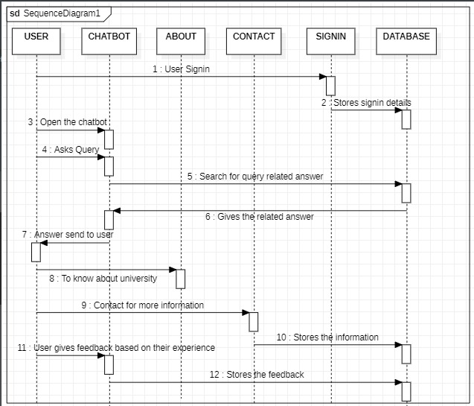
Algorithm

Slide 13
Experimental set up
Frontend/UI :
. HTML/CSS/JavaScript
. Dialog flow messenger
Backend :
. Python
. Flask cors

Slide 14
System hardware & software
HARDWARE:
Processor: CORE i3
RAM: 4GB or Higher
ROM:100GB or higher
OS: windows 10
SOFTWARE:
Visual studio code

Slide 15
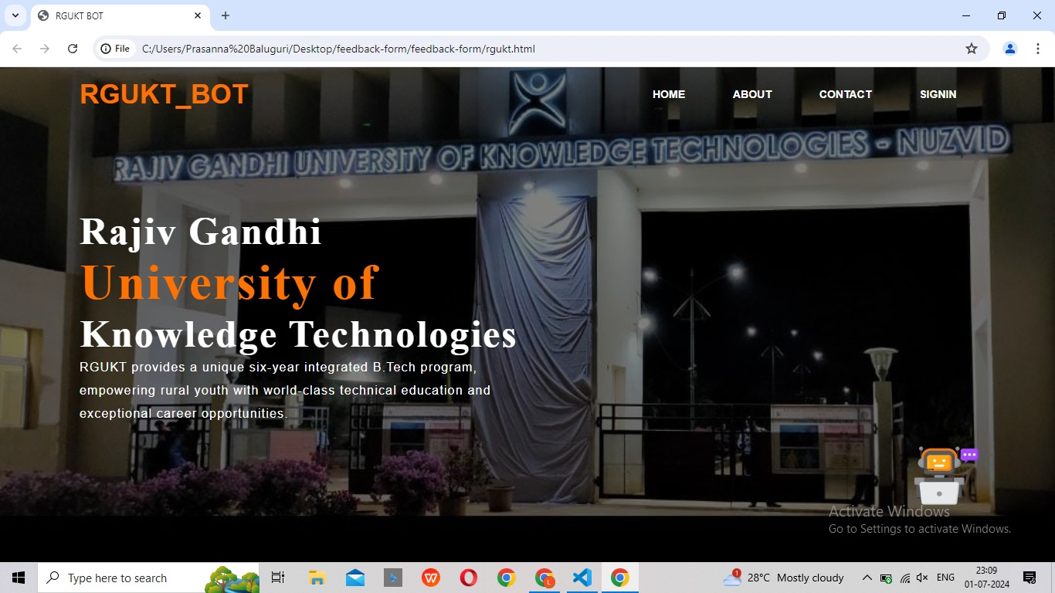

Slide 16
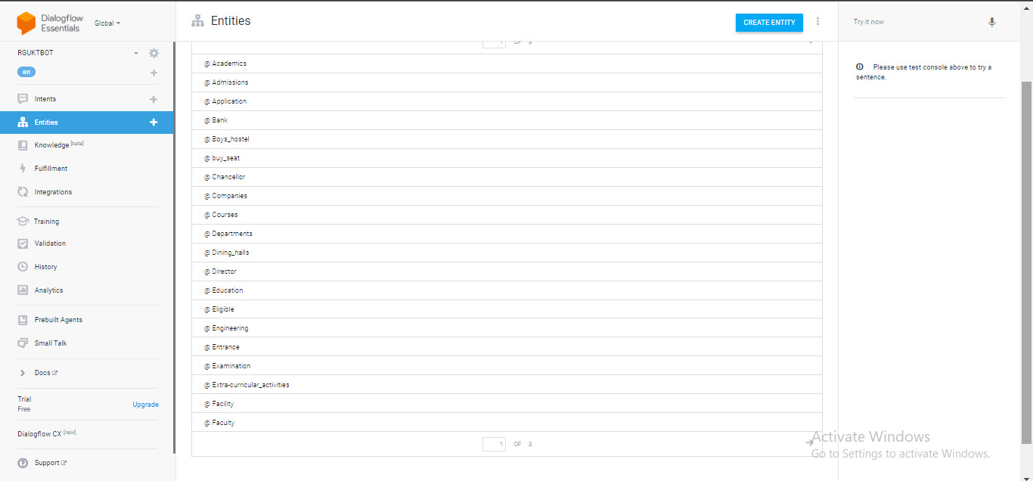

Slide 17
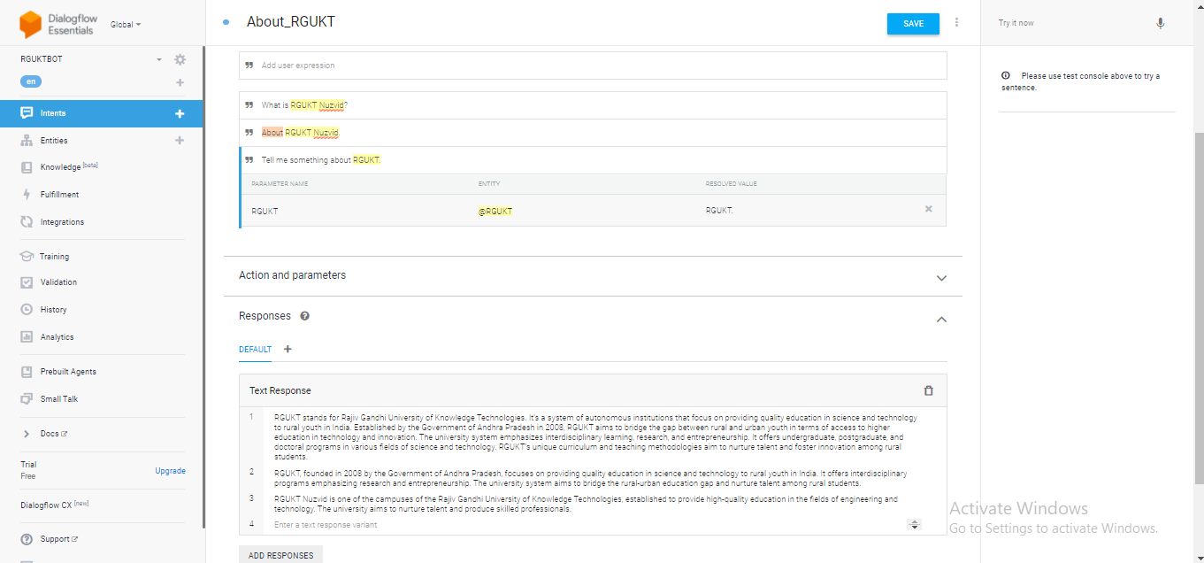

Slide 18
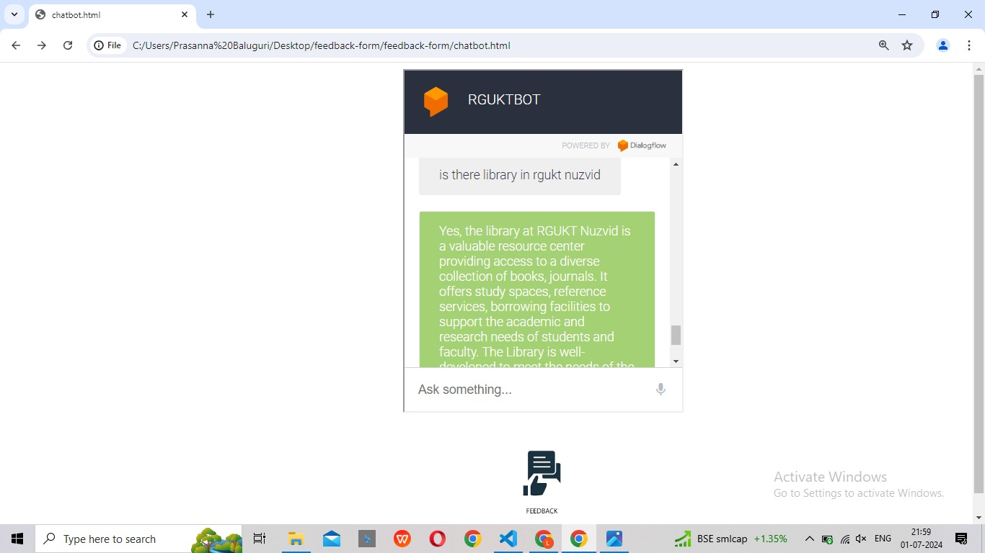

Slide 19
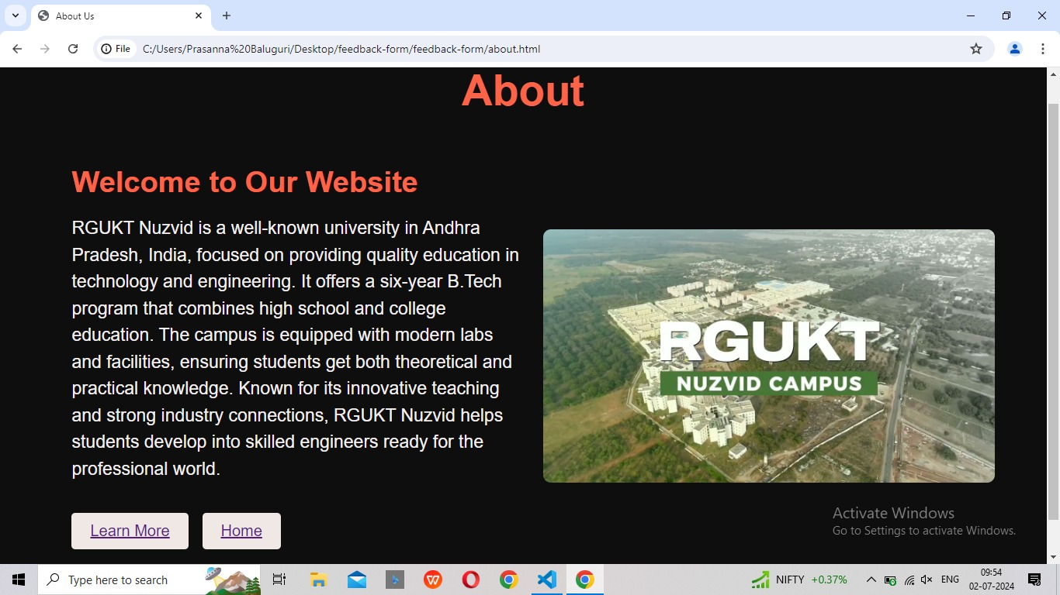

Slide 20
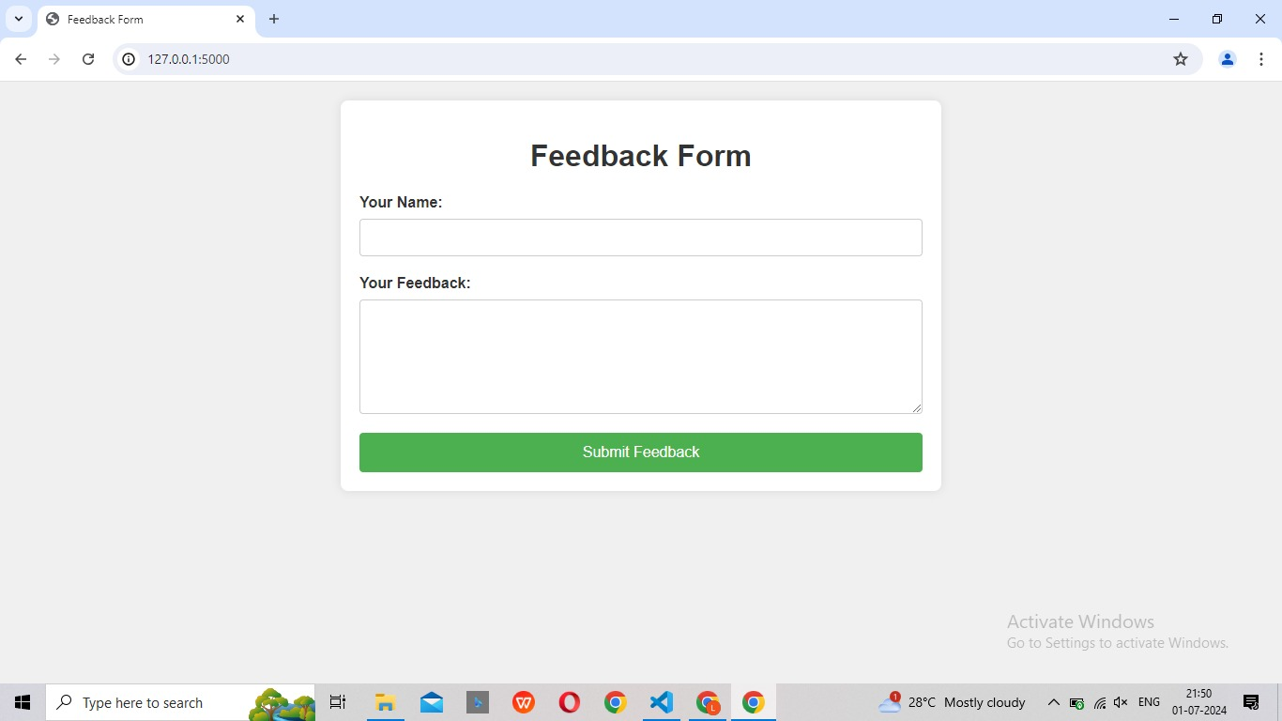
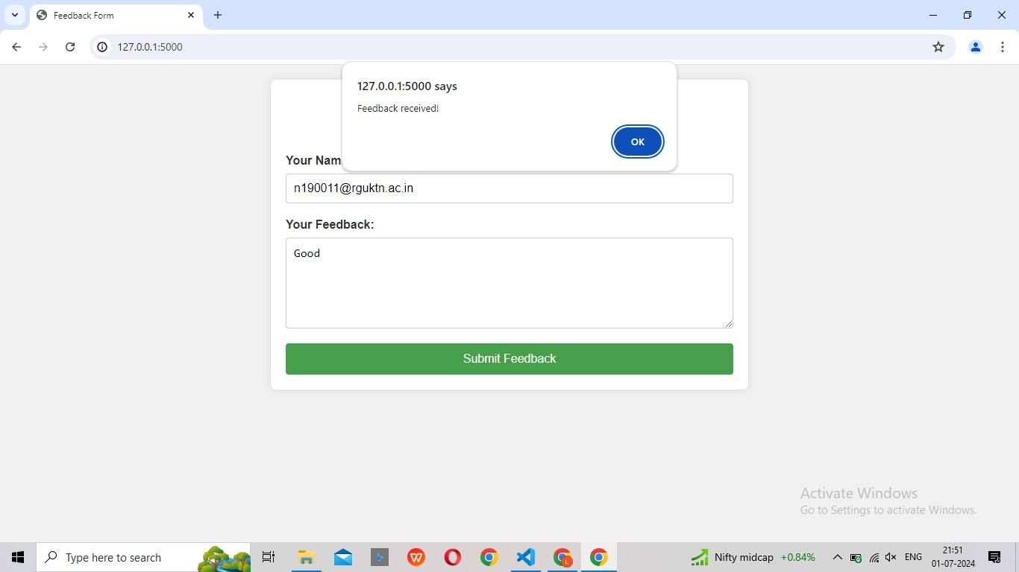

Slide 21
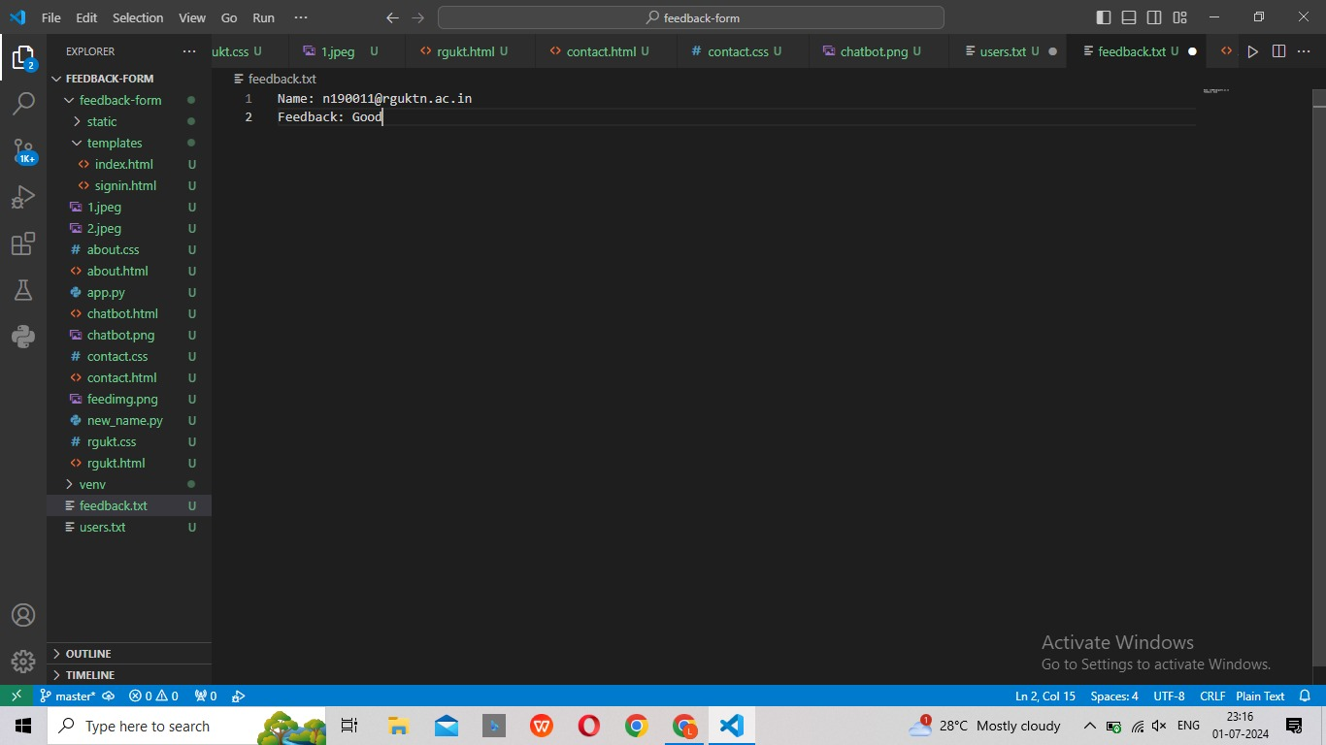

Slide 22
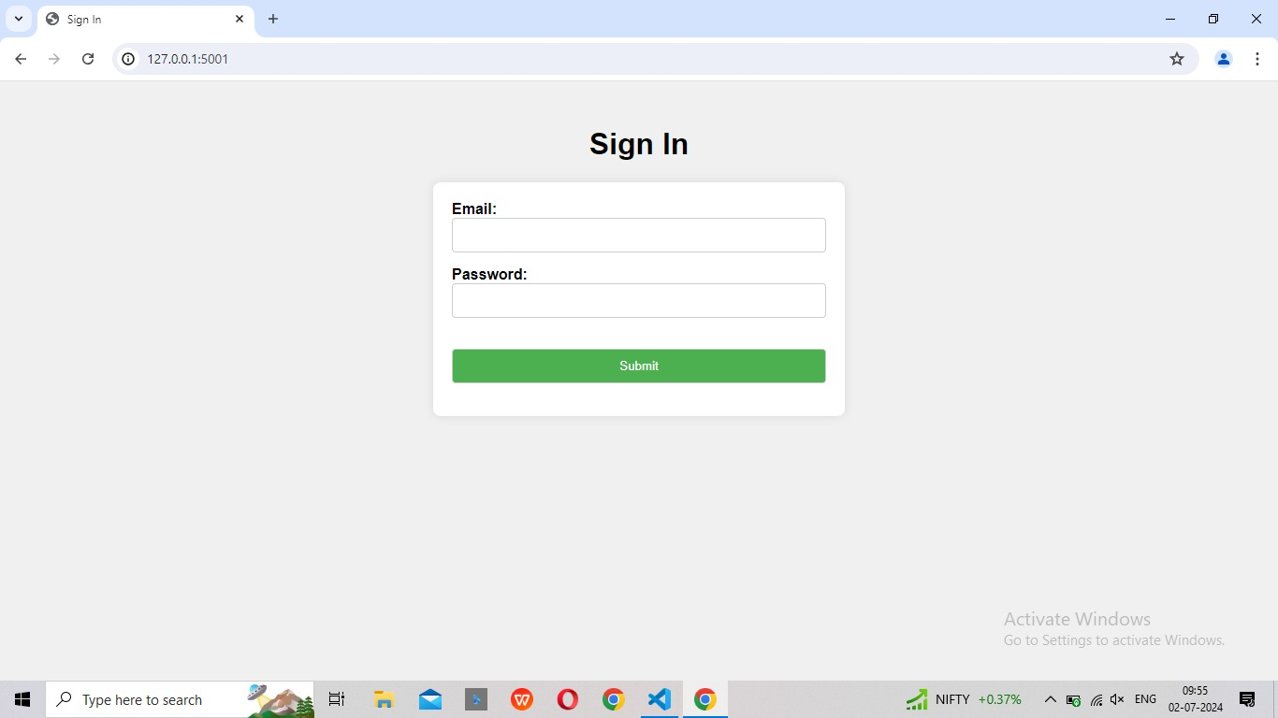
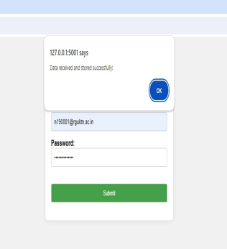

Slide 23
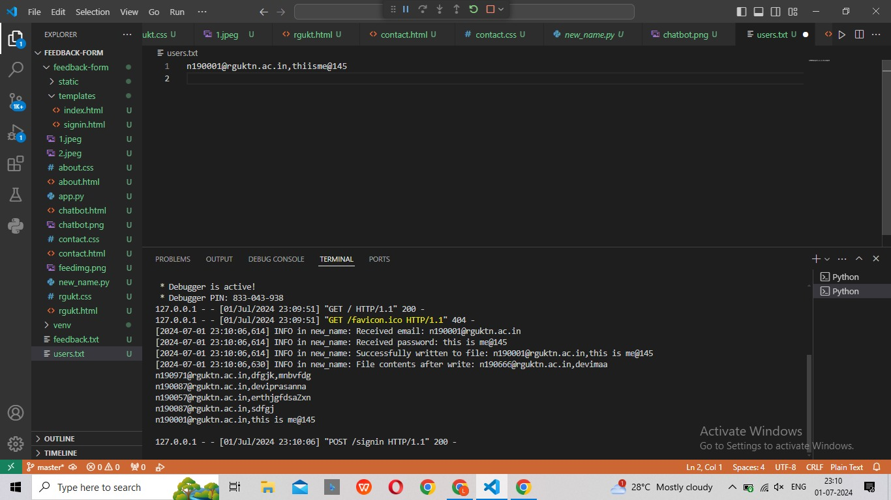

Slide 24
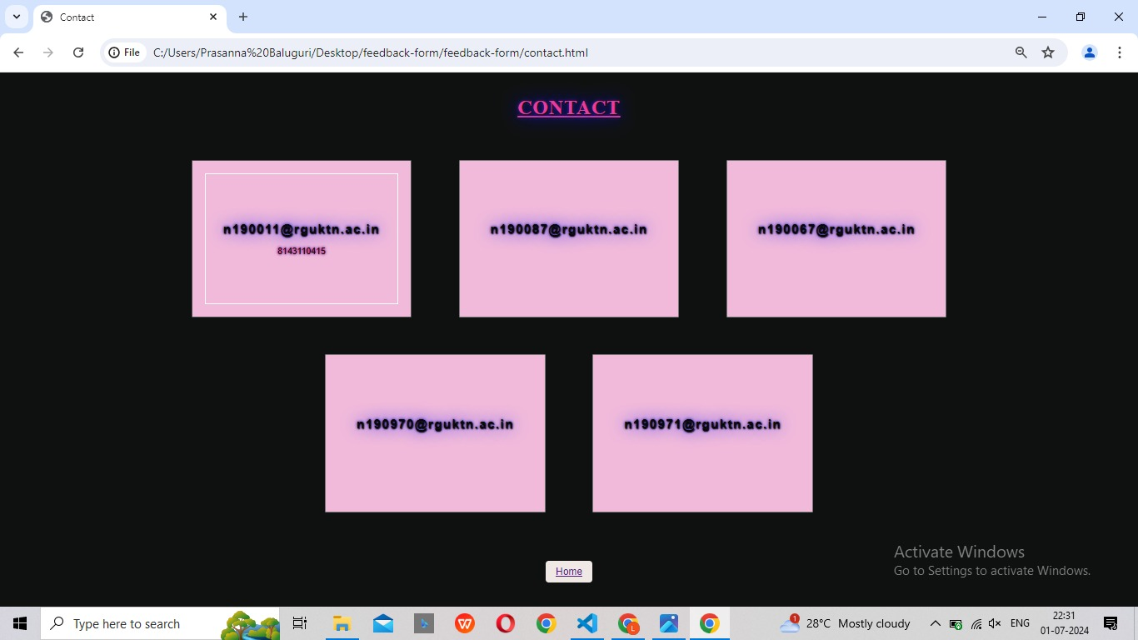

Slide 25
Conclusion
The RGUKTBOT is a smart chat bot designed to help students, faculty, and staff at RGUKT. It uses Dialog flow to understand and respond to questions in natural language, making it easy to use. The bot is connected to a backend server built with Flask, which handles more complex tasks and fetches data from various sources like databases and APIs. This setup allows the bot to provide quick and accurate answers to a wide range of queries, improving communication and efficiency within the university. Overall, the RGUKTBOT combines advanced AI technology with a user-friendly interface to make information easily accessible to everyone at RGUKT

Slide 26
Future Scope
The future of the RGUKT Bot developed with Dialog flow includes supporting multiple languages, integrating with campus systems for better student management, offering personalized responses, ensuring robust security measures, and continuously improving based on user feedback.

Slide 27
Reference
https://www.researchgate.net/publication/346002091_College_Enquiry_Chat-Bot_System
http://www.ir.juit.ac.in:8080/jspui/bitstream/123456789/6794/1/College%20Enquiry%20Chat%20Bot

Slide 28
Thank you

